Slide 1
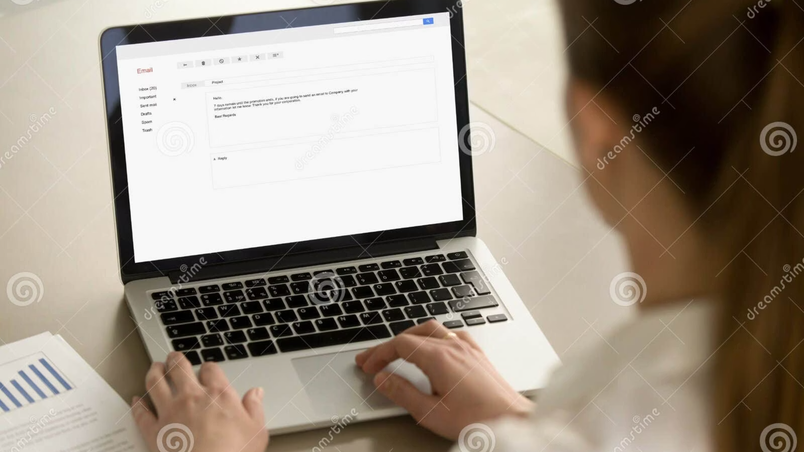
Business Email Assistance
Whether you're making an announcement, following up on a conversation, or delivering difficult news, the way you open and close a business email sets the tone for your entire message. This guide provides a comprehensive reference of professional phrases organized by purpose and formality level — from highly formal to casual — so you can always find the right words for any situation.
Use this document as a quick-reference toolkit to craft emails that are clear, professional, and appropriately toned. Each section covers a specific communication scenario, with phrases ranked from formal to neutral to informal so you can match your language to your audience and context.

Slide 2
How to Start an Email: Making an Announcement
Announcements require careful word choice to match the nature of the news — whether it's positive, neutral, or difficult. The opening line immediately signals the tone of the message, so selecting the right phrase is essential. You can also open an announcement with an infinitive phrase to emphasize purpose, such as To address our issues with… or To better serve our customers…
Formal
Good News
Please be advised that…
Please be aware that…
Effective immediately…
As of (date)…
We are pleased to announce…
We are proud to announce…
Neutral
Bad News
Please note that…
Due to recent events…
As you know…
We regret to announce…

Slide 3
How to Start an Email: Making a Request
Request emails span a wide range of formality depending on your relationship with the recipient and the nature of what you're asking. Formal requests tend to use full constructions like I am writing to request… or I would appreciate it if you could…, while neutral and informal requests use more conversational phrasing. Choosing the right register helps ensure your request is received positively.
Formal Requests
Neutral Requests
I am writing to request…
I am writing in reference to…
I am writing to inquire about…
I would appreciate it if you could…
I was wondering if you could…
Do you think you might be able…?
I am interested in finding out more about…
I would like to know if…
Do you think you could…?
Would you please…?
Could you please send…?
Could you please…?
Can you please…?

Slide 4
How to Start an Email: Following Up & Apologizing
Following up on a prior conversation requires referencing that exchange clearly and professionally. The level of formality depends on your relationship with the recipient. Similarly, apologies in business email range from deeply formal expressions to lighter, informal acknowledgments used for minor issues.
Following Up on a Conversation
Apologizing
Formal
Neutral–Formal
Formal
Informal / Minor Issues
As per our discussion… / Per our discussion… / In reference to our earlier conversation… / This is to confirm that…
As we discussed on (date/day)… / Regarding our conversation on (date/day)…
Please accept our apologies for… / We would like to apologize for… / We sincerely apologize for… / I am deeply sorry for…
I'm sorry, but… (e.g., I'm sorry, but I have to reschedule the meeting) / I'm afraid that… (used to soften bad news)
Informal
As I said on (date/day)… / Like I said on (date/day)…

Slide 5

How to Start an Email: Invitations, Congratulations & Reminders
Extending an Invitation
Congratulating Someone
Reminding Someone
We would like to cordially invite you to… (formal)
You are cordially invited to attend… (formal)
We would be delighted if you joined us… (formal)
We would like to invite you to… (neutral)
You are invited to attend… (neutral)
Would you like to go…? / Any chance you'd like to…? / I'd like to invite you to… (informal)
Congratulations on your…
Congratulations on being…
I was pleased to hear about…
I was happy to hear about…
Just a friendly reminder that…
Just a quick note to remind you about…
Just a brief reminder that…
Have you had a chance to…? (gentle)
Just checking on the status of… (gentle)

Slide 6

How to Start an Email: Bad News, Delays & Complaints
Delivering bad news, responding after a delay, requesting payment, and handling complaints all require a careful, empathetic tone. For bad news, you can also use expressions with due to, after, and despite — for example: Due to (reason) we are unable to…, After evaluating…, or Despite our best efforts,… For payment reminders, note that if multiple emails are needed, the tone typically becomes progressively more direct.
Delivering Bad News
Responding After a Delay
We are sorry to inform you…
We regret to inform you…
We regret to announce…
Please excuse the delay in responding… (formal)
I apologize for the delayed response. (formal)
Sorry for taking so long to get back to you. (neutral–informal)
Requesting Payment
Responding to a Complaint
Our records show…
According to our records…
This is a reminder that…
Thanks for letting us know about…
Thank you for informing us about…
Thank you for sharing your experience…
Thank you for taking the time to write…
Many experts recommend starting complaint responses by thanking the customer first. The actual apology typically comes later in the email. Common apology expressions include: We're sorry for any frustration this may have caused. / We're sorry for any inconvenience this may have caused. / We sincerely apologize for…

Slide 7
How to Start an Email: Acknowledgement
Acknowledgement openers confirm receipt of a message, order, or action and immediately signal attentiveness and professionalism to the recipient. These phrases are especially useful in customer-facing communications and internal correspondence where confirming receipt is important.
Thank you for your prompt reply… (formal)
Ideal for responding quickly to a formal message or proposal.
Thanks for getting back to me so quickly… (neutral)
A warmer, slightly less formal way to acknowledge a fast response.
Thank you for the detailed response… (formal)
Acknowledges the effort the recipient put into their reply.
Thank you for your order of… / Thank you for completing… (neutral)
Used in transactional or operational contexts to confirm an action.
This is to confirm that we have received… / Thank you for your email… (neutral)
Straightforward confirmation phrases suitable for most business contexts.

Slide 8
How to End an Email: Announcements & Requests
Closing lines for announcements typically invite questions and express gratitude for the reader's patience or cooperation. For requests, the closing should reinforce appreciation and signal whether a response is expected. Urgency can be expressed through phrases like Thank you in advance for your prompt reply or Please get back to me as soon as possible.
Closing an Announcement
Closing a Request
Should you have any questions or concerns, please contact me. (formal)
Should you have questions, please don't hesitate to contact us. (formal)
If you have any questions, please contact me. (neutral)
If you have any questions, please let me know. (neutral)
If you have any questions, please call us at… (neutral – external)
Feel free to contact us if you have any questions. (neutral – external)
Thank you for your patience and understanding. (formal – delay)
Thank you for your cooperation. (neutral – mass announcement)
Thank you for giving this request your consideration. (formal)
Thank you for your consideration. (formal)
I look forward to your reply. (formal)
I appreciate your assistance. (formal)
I appreciate your help. (neutral)
Thanks for your help. (neutral)
I look forward to hearing from you… (neutral – external)
I hope to hear from you soon. (neutral – external)
Thank you for your time. (formal)
Please contact me at your earliest convenience. (formal)
Thank you in advance for your prompt reply. (formal – urgent)
Please get back to me as soon as possible. (neutral – urgent)

Slide 9
How to End an Email: Responses, Apologies, Invitations & Meetings
Responding to a Request
Apologizing / Responding to a Complaint
Extending an Invitation
Let me know if I can be of assistance in any way. (formal)
Let me know if there's anything else I can do. (neutral)
Let me know if you need anything else on my end. (neutral)
Hope this helps. (neutral/informal — often used as a sign-off)
I sincerely hope you can attend. (formal)
I hope you can attend. (neutral)
I hope to see you there. (neutral)
Once again, sincere apologies for…
Once again, we regret…
We apologize for the misunderstanding.
Requesting a Meeting
Other Closings
I look forward to meeting with you… (formal)
I hope to see you soon… (neutral)
Thank you for your continued business. (formal — regular customer)
Thank you for choosing… (acknowledgement of an order)

Slide 10

Email Sign-Offs: The Final Word
Your sign-off is the last impression you leave on the reader. Choosing the right closing word or phrase reinforces the tone of your entire email. Formal sign-offs like Warm regards and Best regards are safe choices for most professional contexts, while neutral options like Best, Thanks, and Regards work well for ongoing correspondence with familiar contacts.
Formal Sign-Offs
Situational Sign-Offs
Warm regards,
Best regards,
These closing phrases double as sign-offs and are appropriate in specific contexts:
Neutral Sign-Offs
Have a great weekend.
Have a great night.
Hope this helps.
Keep up the good work. (from a supervisor to an employee)
Best,
Regards,
Thank you,
Thanks,
Thanks again,
When in doubt, Best regards is the most universally appropriate sign-off across industries and formality levels. Reserve casual sign-offs like Have a great weekend for colleagues you communicate with regularly.

